Slide 1
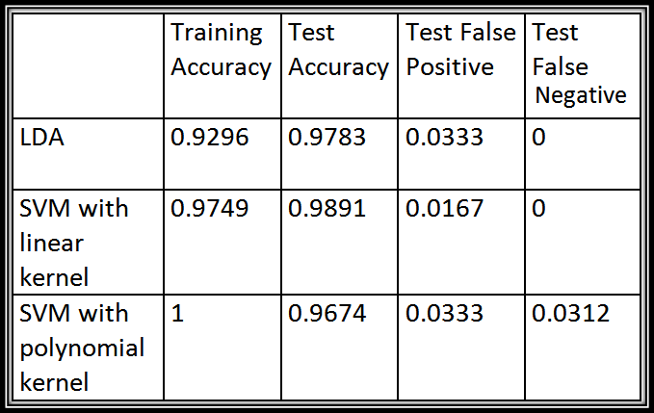
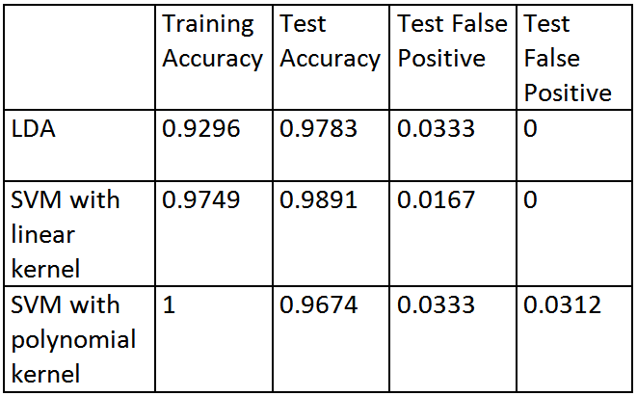
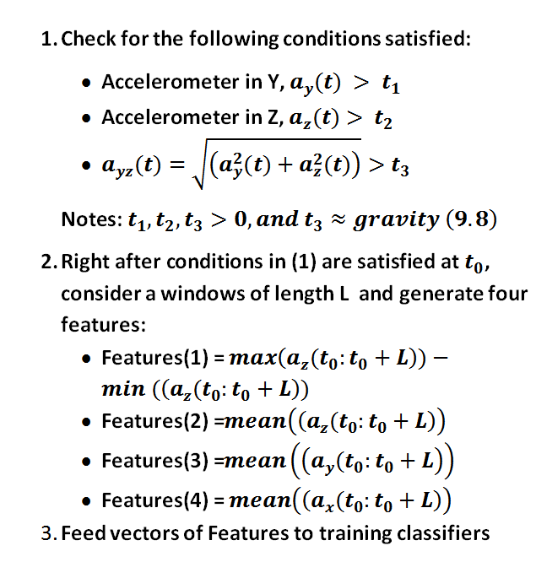
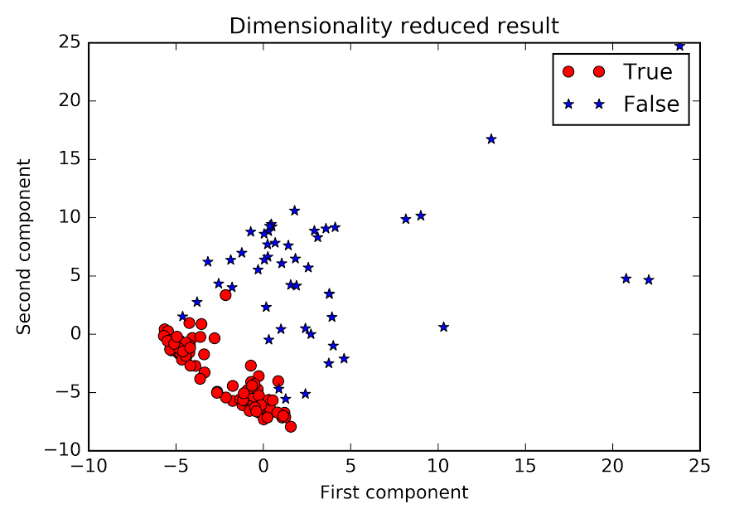
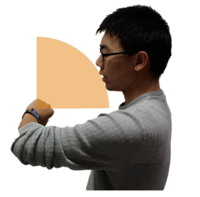
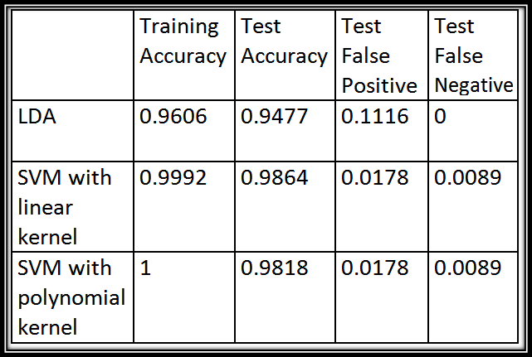
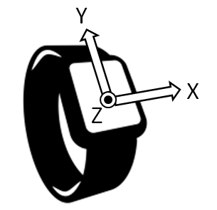
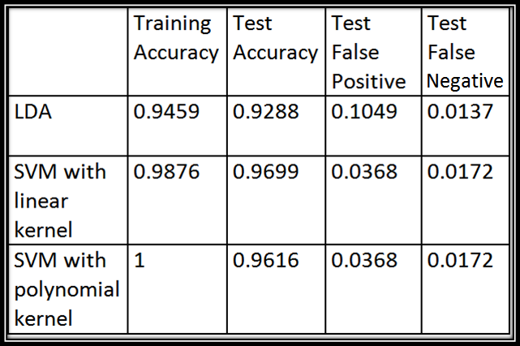
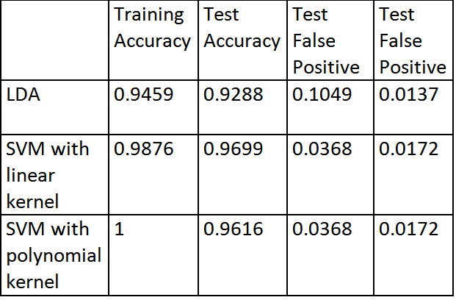
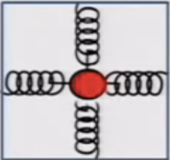
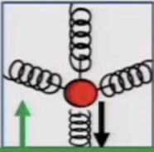

A SMARTWACTH ACTIVATION SYSTEM DESIGN
Sheng Shen, Jifu Zhao and Duc Phan CS 598 Final Project, University of Illinois at Urbana-Champaign
Motivation
Recent years have witnessed the boost in the wearable device community, and wrist-worn smart watches are getting popular. As opposed to the rich set of sensors and functionality, smartwatches are always suffering from short battery life, typically less than one day. This limitation prevents one of the biggest battery drainer, the smartatch’s screen, from being always on. As a result, whenever the user needs to look at the watch to get the time, a tapping on the screen is required, making this most basic functionality inconvenience.
In order to remediate this issue, we are developing an accurate activation system based on wrist raise detection by monitoring sensors of smartwatch.
Goal:
In the scope of a term projects we set a following goals:
Assuming that the body is stationary, our first goal is to design an algorithm that effectively differentiates the motion of raising wrist to see time from other similar motions, such as lifting hand to perform other tasks
Secondly, we want to detect the motion of raising wrist to see time from other general human activities, while the body is moving such as walking, running and etc.
Findings
Data Collections:
We developed an Android app to record all sensor readings from smartwatch. Data used for this project is generated by three difference users.
Data is labeled in four categories: true_static, false_static where users are stationary, and true_moving, false_moving where users are moving.
Observations :
Looking at time on smartwatch could be decomposed into a sequence of actions:
Wrist movement into region of interest => rising edge in term of accelerometer reading for Z and Y axes
A short pause => gravity vector is stable; sensor reading variance decreases.
Notes: some false_movings could generate the above sequence, but the reading value at final position is different.
Solution
Ideas:
We first need to detect whether the smartwatch is in the region of interest (the states where user can possibly look at the watch;
If the smartwatch is in the region of interest, we generate a set of features from accelerometer readings to feed into a classifier to detect whether the current state is the state in which user is looking at time.
Results:
Three classifiers, including LDA, SVM with linear kernel and polynomial kernel (order of 3), are used to measure the performance of our algorithms
Table 3.Results when restrict training sets include data of two users, and the test set data belongs to remaining user.
Fig 7. Data visualization after performing PCA
Fig 6. Detail implementation
Conclusions
Our algorithm can achieve 98% accuracy in test set.
Visualization of the data and the results from difference classifiers suggest that linear classifiers, such as LDA or SVM with linear kernel, are sufficient.
Fig 3. Region of Interest ; user hand position for looking at time.
Smartwatch Basics:
Sensor of Interest:
Accelerometer: measures acceleration along X, Y and Z (includes gravity); wildly available in wearable devices; costs the least energy compared to other sensors.
Fig 4. A samle reading from false_moving which generates a similar sequence to true_moving; but means and variance at final position are different
Fig 1.Convention coordinates for sensor data readings in smartwatch. Z is pointing out of watch face. The reference of the coordinate is on the smartwatch.
Future Work
Test on more users and report accuracy.
Report energy usage (e.g. with different sampling rates)
User feedback to evaluate latency
Table 1. Results for static data (assume user body is stationary)
Fig 2.Conceptual understanding of accelerometer and an example reading measures gravity.
Fig 5. An Illustration of the observations from Accelerometer readings for a true_moving
Table 2. Results for all data ( including cases in which user‘s body is static or moving)

